Slide 1
NZIFST Annual Conference
Awards Dinner Citations 2024

Slide 2
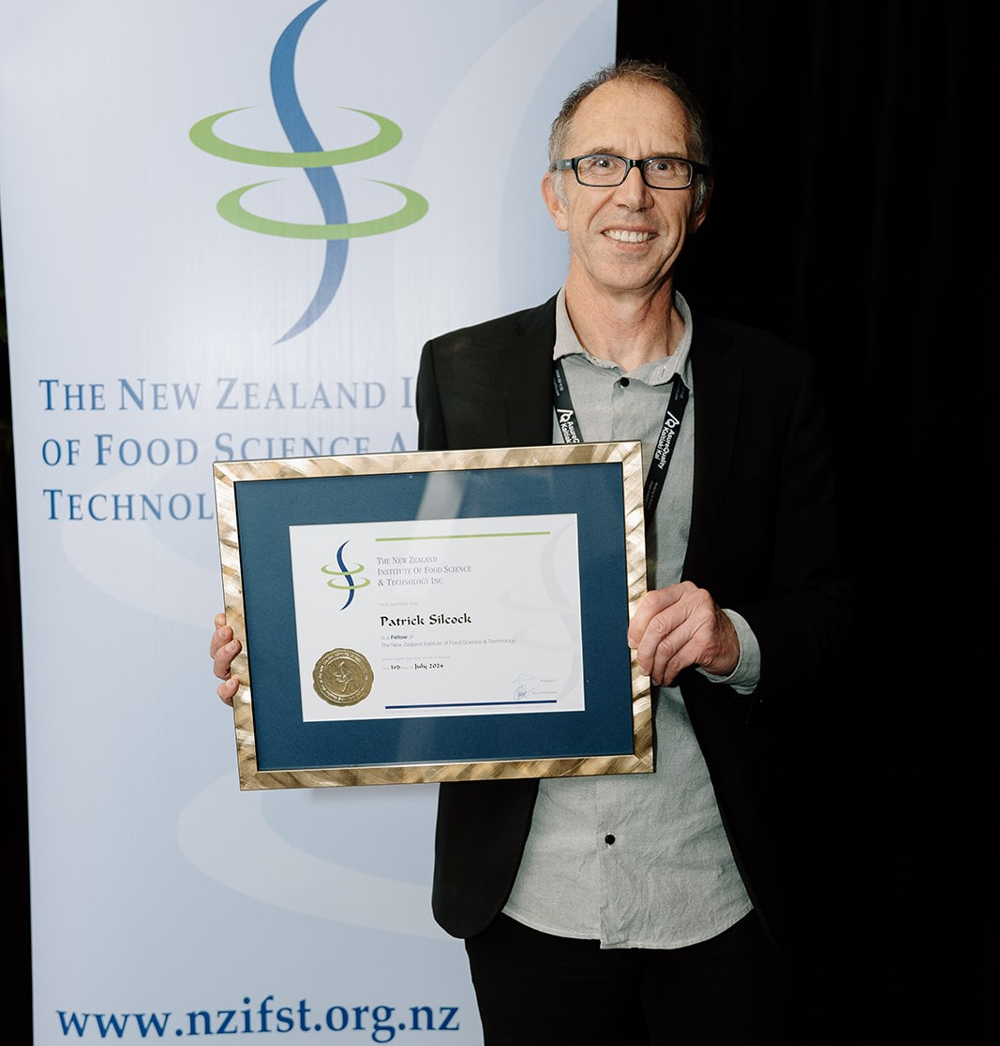
Fellow – Pat Silcock
Our first Fellow for 2024 has an impressive record of carrying out R&D leading to the creation of new knowledge for the food industry. He has been part of the commercially funded Product Development Research Centre in the Department of Food Science, University of Otago for 30 years and the Manager for the last 20 years. The longevity of the PDRC, the amount of return business this person has generated over PDRC’s more than 30-year tenure and the number of products and patents (7) produced are evidence of the value of his food science expertise to the food industry.
He is an effective science communicator and a well-liked and respected in his teaching roles with 182 scientific conference presentations plus numerous industry presentations.
He has fulfilled roles in support of industry bodies throughout his career and contributed hugely to NZIFST through his local branch, as a committee member for many years and served as a member of the NZIFST Board and is a past recipient of the NZIFST Ron Hooker award for service to a branch of the Institute

Slide 3
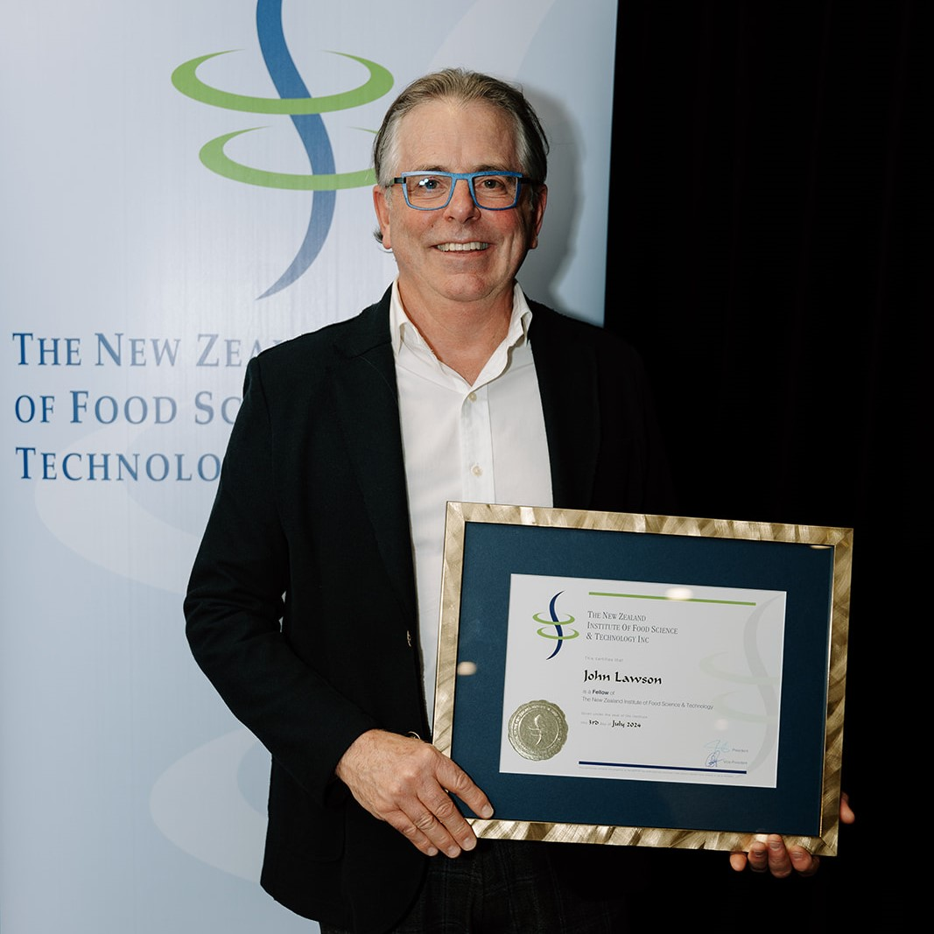
Fellow – John Lawson
Our next Fellow studied Biotechnology and Bioprocess engineering at Massey University and worked in the dairy, food and beverage industries before joining the recruitment industry and establishing his own agency in l992. The agency has a reputation for providing quality recruitment services to New Zealand businesses with a particular skill in the food sector. His integrity and professionalism is beyond reproach.
Through this work he has made a valuable contribution to our industry. His company has strong relationships with many of New Zealand's large food companies, ensuring that their staff needs are filled.
He is always approachable, freely sharing his knowledge and expertise with the entire Institute around how to build the best possible career for NZIFST members for the long term. Many of our members will have been helped find a role, or a staff member, by this man and his company.
Regarding the NZIFST, he has been a quiet contributor to our organisation, working actively in the Career Promotion programmes in the 1990s, writing a regular careers column for Food New Zealand since 2005, presenting at five conferences during that time and sponsoring the Young Technologists Careers evenings on several occasions. He is currently working with our Board on the lnstitute's Strategy Refresh project. Those involved in the Institute may take for granted his advice and support, but it is rare for recruiters to do this.

Slide 4
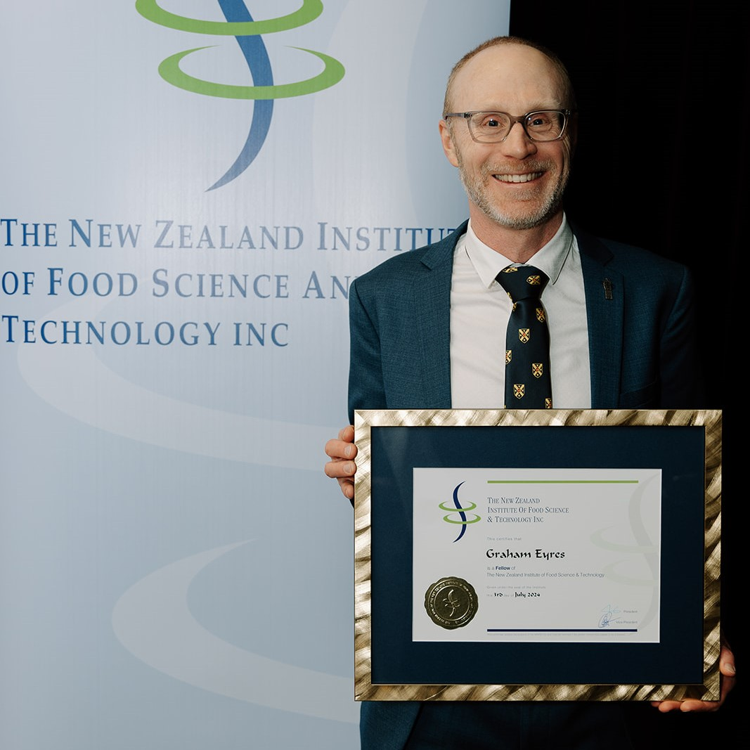
Fellow – Graham Eyres
Our next Fellow is an excellent communicator and a well-liked and respected teacher and supervisor of undergraduate and post-graduate students. He has
an impressive record of carrying out research and development leading to the creation of new knowledge for the food industry as evidenced by his 7 book chapters, 54 scientific papers, and 10 refereed conference proceedings
He also has an extensive track record of governmental research funding, including research on 17 industry funded projects.
He has a strong record in supporting the food industry through media commentary and involvement with activities designed to promote careers including his extensive involvement with Hands- on at Otago (2015-2024) and numerous School visits.
He is actively involved in our Institute, holding the position of Chair of his local branch for 8 years, and staying on the committee since then as Secretary. His contribution to the 2022 conference and Chairing of the 2023 conference was valued by all.
His quiet effectiveness sees his many projects through to a successful conclusion.

Slide 5
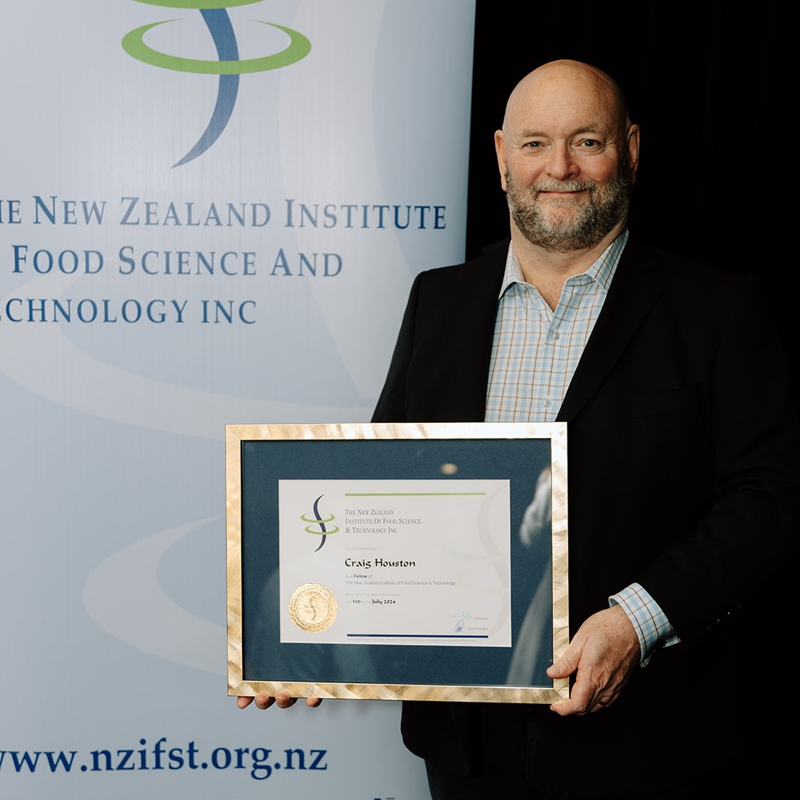
Fellow – Craig Houston
Our next Fellow has a rich tapestry of experience in research, development, and industry advancement. For a decade, he served as Project Manager/Product Manager at ANZCO Foods, where his visionary leadership and strategic acumen drove the inception and execution of groundbreaking initiatives.
Prior to that, he spent seven-years as Lab Manager for the ESR Food Micro and Food Chemistry lab where he facilitated pivotal research endeavours in collaboration with MPI, delving into critical areas such as food composition, contamination effects, and novel detection methodologies.
His contribution to NZIFST is notable, with service in three conference committees and at branch level he has been an active member of the Canterbury Branch Committee for 10 years, including 3 years as treasurer, culminating in a four-year chairmanship. He also served on the NZIFST Board as a branch representative for 4 years.
Beyond the confines of the NZIFST, His engagement with industry bodies such as BioTechNZ as a board member for 4 years and the Institute of Directors, underscores his commitment to broader industry advancement and professional development.
He embodies the ethos of the NZIFST and continues to contribute towards further advancements in the realms of food science, technology, and industry development. His personal dedication, professional expertise, and collaborative spirit make him an exceptional candidate for fellowship

Slide 6
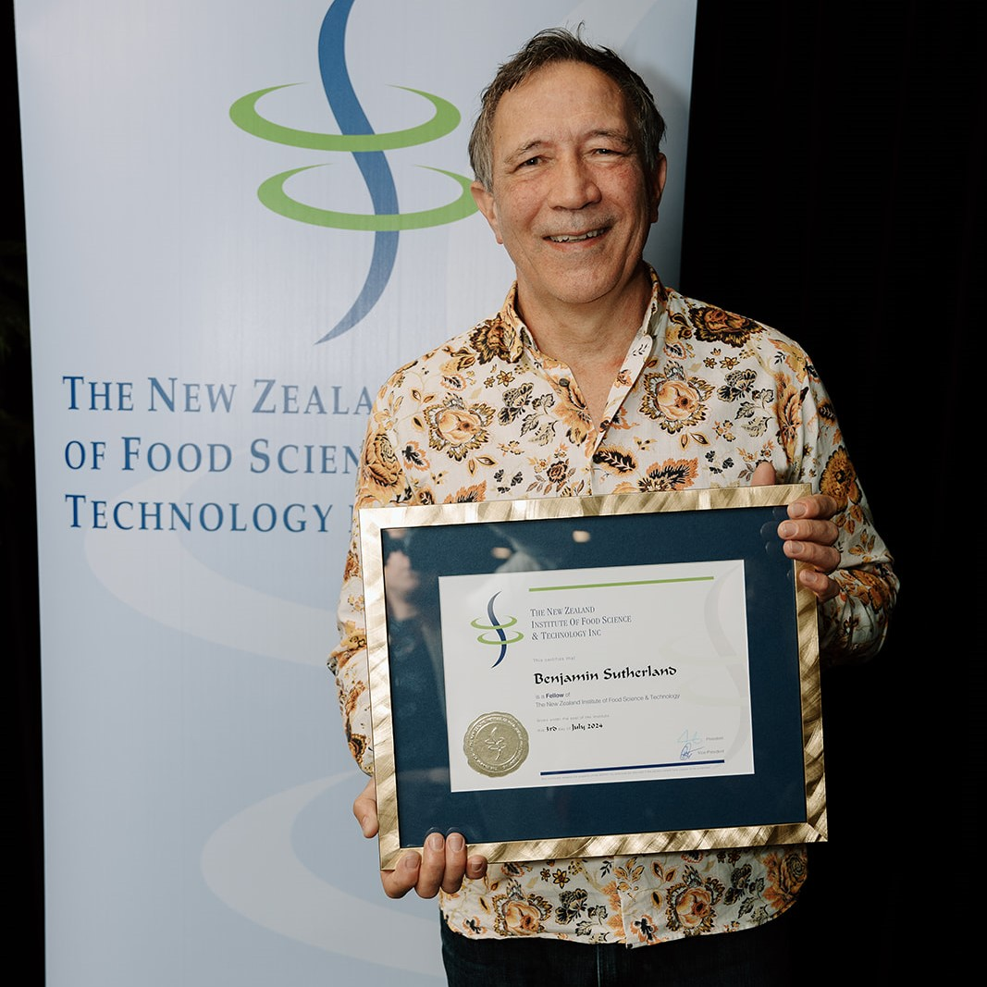
Fellow – Ben Sutherland
Our next, and final Fellow for this year has made an outstanding contribution to the institute and our industry.
He started his working life as a professional chef, before completing his degree in Food Science at the University of Otago.
His early food technology career was engaged in product development in New Zealand and in Australia. His roles spanned a variety of sectors in our industry: probiotics, chocolate, meat, and a variety of FMCG companies.
For the last 10 years he has been Principal Food Technologist at Food Standards Australia New Zealand (FSANZ). This senior role involves risk management and the provision of food technology input to applications and proposals that seek to amend the Code, including standards associated with food additives, processing aids, novel foods, irradiation, commodity standards, chemical contaminants, prohibited botanicals and genetically modified foods. He also represents FSANZ externally in national and international forums and keeps abreast of emerging issues related to food technology that may have a regulatory impact.
He is a strategic thinker with extended networks. He is able to work with the multiple disciplines within FSANZ and the trans-Tasman regulatory agencies, including New Zealand Food Safety (NZFS) and the Ministry for Primary Industries and stakeholders.
He is an active member of NZIFST Central Branch having acted as Chairman for several years and longer as committee member. He has hosted numerous meetings and presentations during this time. He is adept at keeping the Branch together and active, committee meetings rolling along.

Slide 7
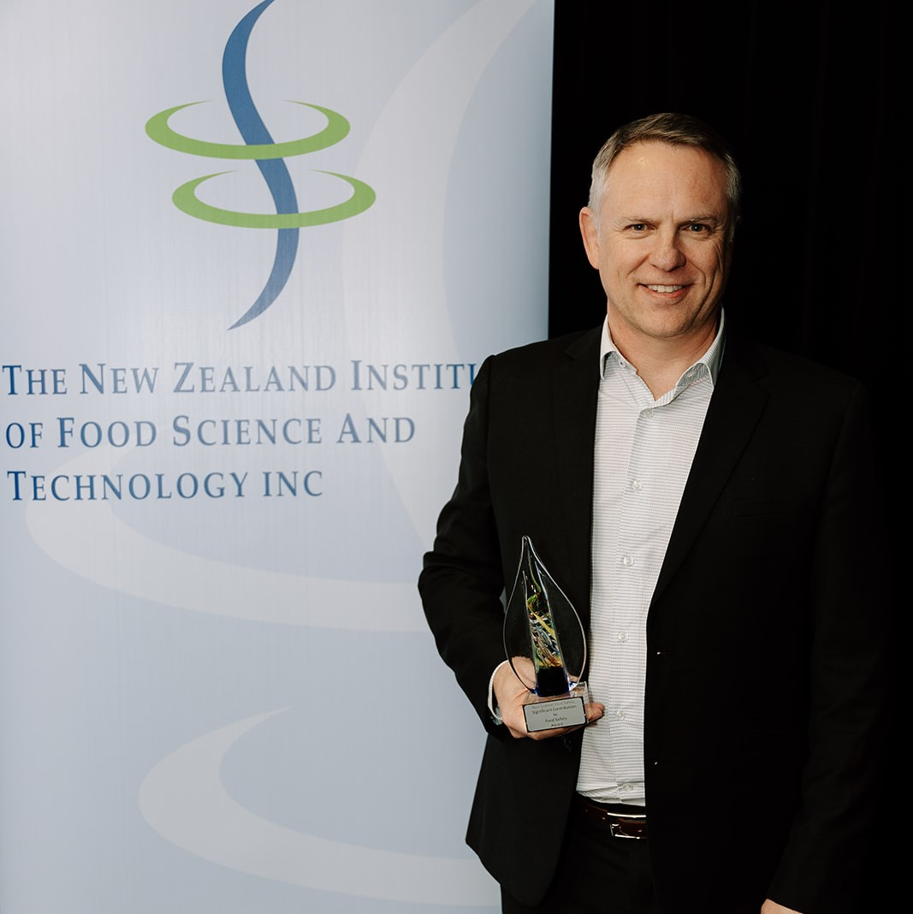
Significant Contribution to Food Safety Award – Pierre Venter
The Significant Contribution to Food Safety Award is sponsored by New Zealand Food Safety.
Dr Venter leads a team at Fonterra Co-operative Group Limited who are behind the co-operative's food safety and quality science that underpins risk management.
As Director of Research and Development at Fonterra, Dr Venter has more than 20 years of innovation and extensive experience under his belt.
Dr Venter has contributed immensely to food safety in New Zealand and internationally throughout his career. He has built a reputation for transformation, operations optimisation, innovative strategic thinking, working with the highest level of integrity, and a deep commitment to product leadership culture and people development.
Among his team's many significant achievements are 2 global patents: a tool for advanced risk communication with a broad range of risk managers, including regulators and customers, and spatial modelling of pathogen distribution inside manufacturing facilities.
He has shown leadership in food safety science more broadly through his active support of other New Zealand businesses, dealing with food safety and quality challenges, fundamental research supervising post-graduate students, and his contributions to the New Zealand Food Safety and Science Research Centre.

Slide 8
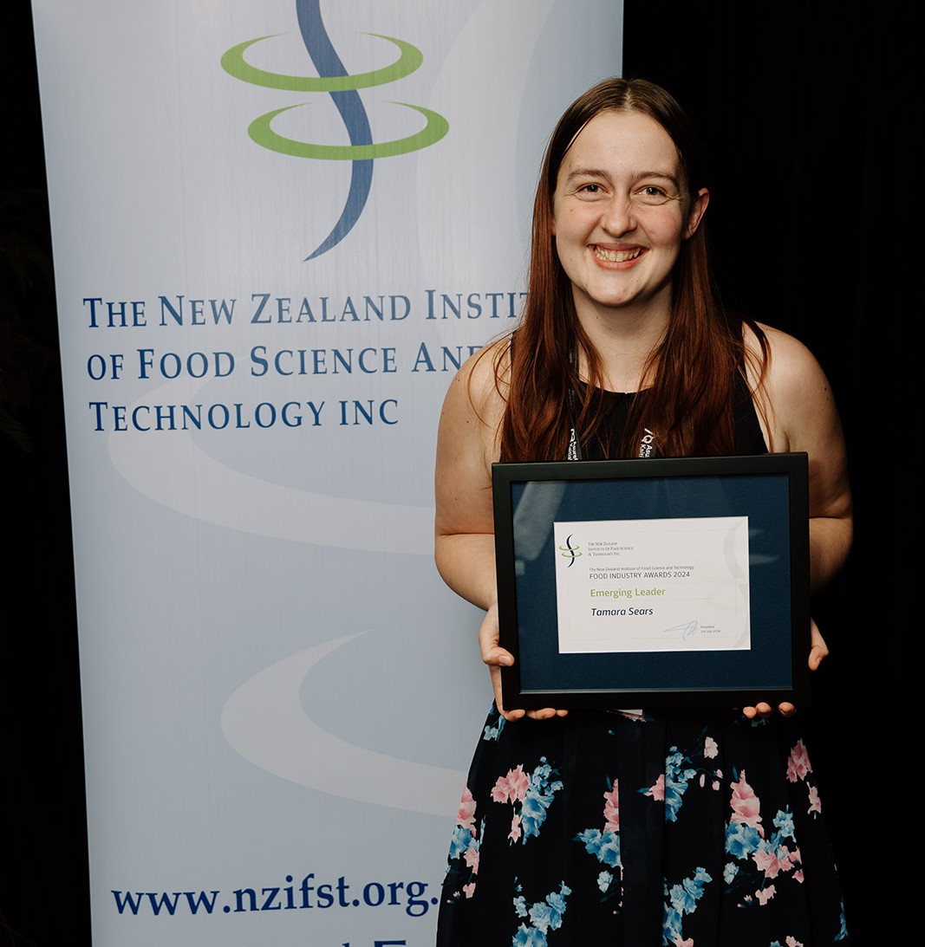
Emerging Leader – Tamara Sears
This award is to recognise a young technologist, or scientist, or engineer for their endeavour or achievement, and leadership potential, within the food industry.
This year’s winner graduated with a Bachelor of Food Technology (Honours) from Massey University in 2018. While completing her studies, she worked as a Research Assistant at Comvita Limited as well as a summer intern at the Fonterra Research & Development Centre. On graduation she joined Fonterra Brands NZ in 2018 as a Development Technologist for Cheese & Spreads based in Eltham Taranaki and last year, she was been promoted to Senior Development Technologist.
In this role she continues to shine and show her abilities to help others grow and has shown great leadership at a site level supporting with key initiatives and strategic discussions on long term business planning.
Tamara has significant leadership potential both inside and outside work. She is always willing to help others by sharing her knowledge, supporting and coaching new technologists in systems such as Hamilton Grant as the R&D representative and teaching others the ways of working.

Slide 9
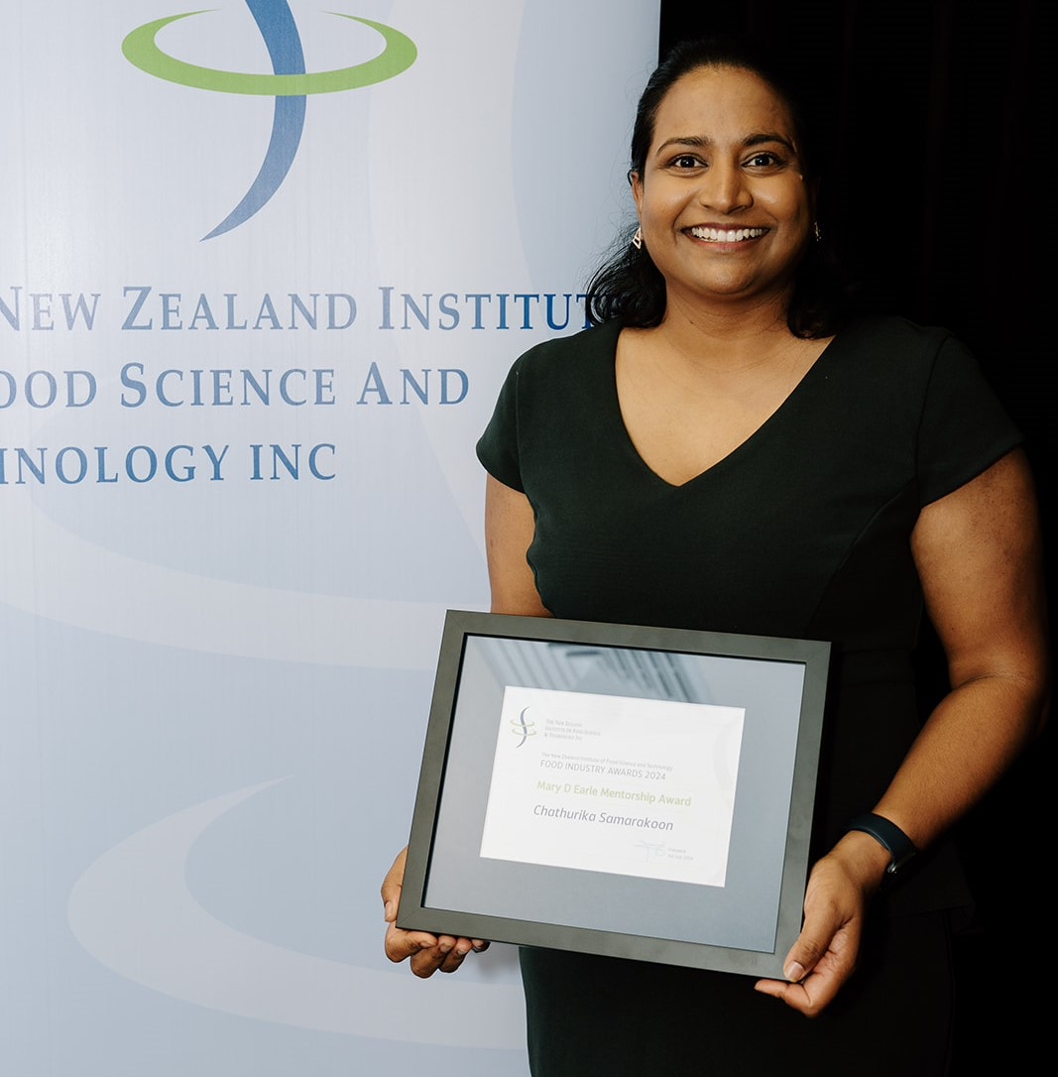
Mary Earle Mentorship Award – Chathurika Samarakoon
This award recognises members who have excelled at mentoring others in achieving their career objectives through moral, social and intellectual support.
This person is a principal lecturer, researcher, an innovator, the Chair of the Waikato branch of the NZIFST and a supporter of future food scientists and technologists.
She brings a passion and enthusiasm to education which is inspirational. She was also a major driver behind Wintec’s involvement in Science Spinners, bringing STEM education to under-privileged schools, and other instances of encouraging Students into Food Science, such as career days and campus tours.
As Chair of Waikato Branch, she developed a strong and holistic plan for the branch to revive it and bring energy to it. Her ideas around FED Talks were so successful these have now been implemented nationally.
Her passion for promoting and inspiring future food scientists and technologists is evident in everything she does, and her students are very lucky to have her. She puts focus on organising student tours to food industries and organises guest speakers to Wintec to spark the interest of her students in science and technology and show them how their studies are applied in the working world.
She also engages in community work where she is a committee member at the Sri Lanka Friendship Society Waikato.

Slide 10
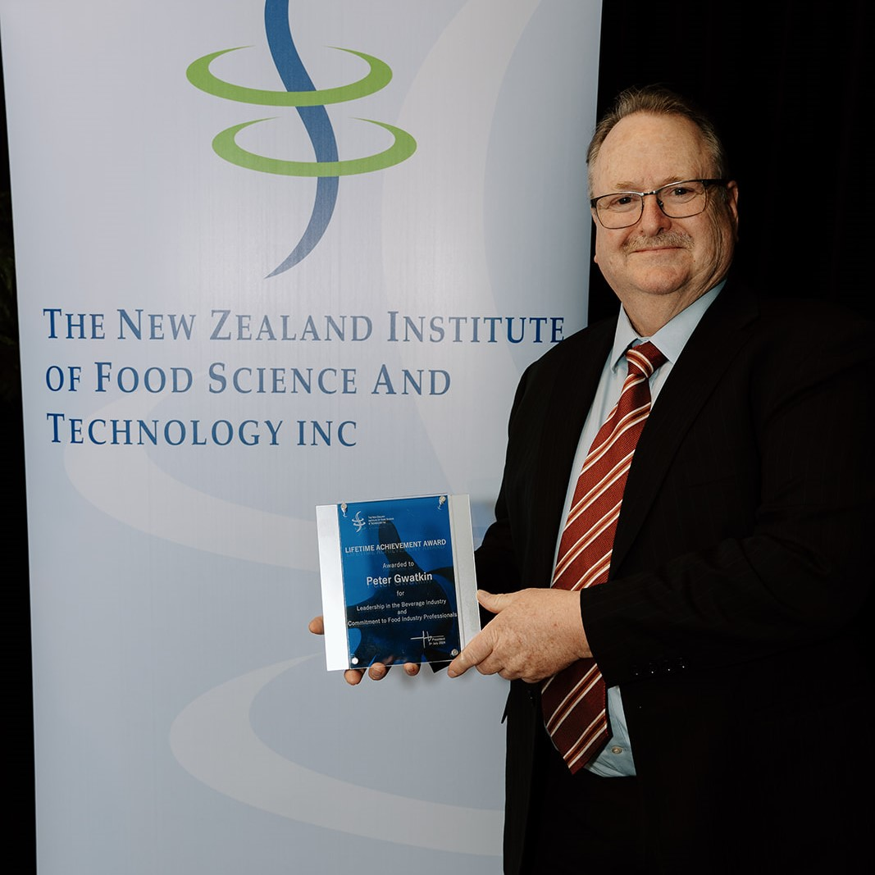
Lifetime Achievement Award – Peter Gwatkin
This award, formerly known as the Distinguished Service Award, recognises long and exceptional service and/or contribution to a New Zealand Food Industry sector in a scientific, technical, teaching, marketing or managerial role; and is specifically for industry personnel approaching, or in retirement.
This man’s working life started following graduation with a BSc (Hons) from the University of New South Wales when he joined CSIRO as an experimental scientist on topics as broad as salmonella decontamination of chicken and treatment of dried vine fruit washes.
In 1985 a move to Mildura Fruit Juices as Chief Chemist was the start of a lifetime involvement in, and the development of in-depth knowledge of the beverage industry.
The move to New Zealand came when he joined Universal Flavours (now Sensient Technologies) in 1991, with the goal to create a technical department. From a lab the size of a store cupboard, he established processes and systems for R&D and Quality Control. He was also developing new flavours, colours and specialty sauces on behalf of New Zealand companies for local manufacture. Many of these products are still on the shelves. He was at the forefront of innovation in the beverage industry during the evolution of Energy drinks and other ‘new age beverages’ as they were once called.
He has also helped train many new food technology graduates in the fundamentals of beverage formulation – his knowledge meant he was instrumental in establishing a flavours and colours training workshop taught at tertiary level.
When the New Zealand Juice Council (now the Juice and Beverage Association) was established, his involvement was immediate, on the Technical committee; as an advocate for the industry to Government and later, on the Compliance Committee. His knowledge of the regulations paired with his technical knowledge on beverages was invaluable to both committees.
We cannot think of anyone more deserving of this award than “Encyclopaedia Gwatanica…”

Slide 11
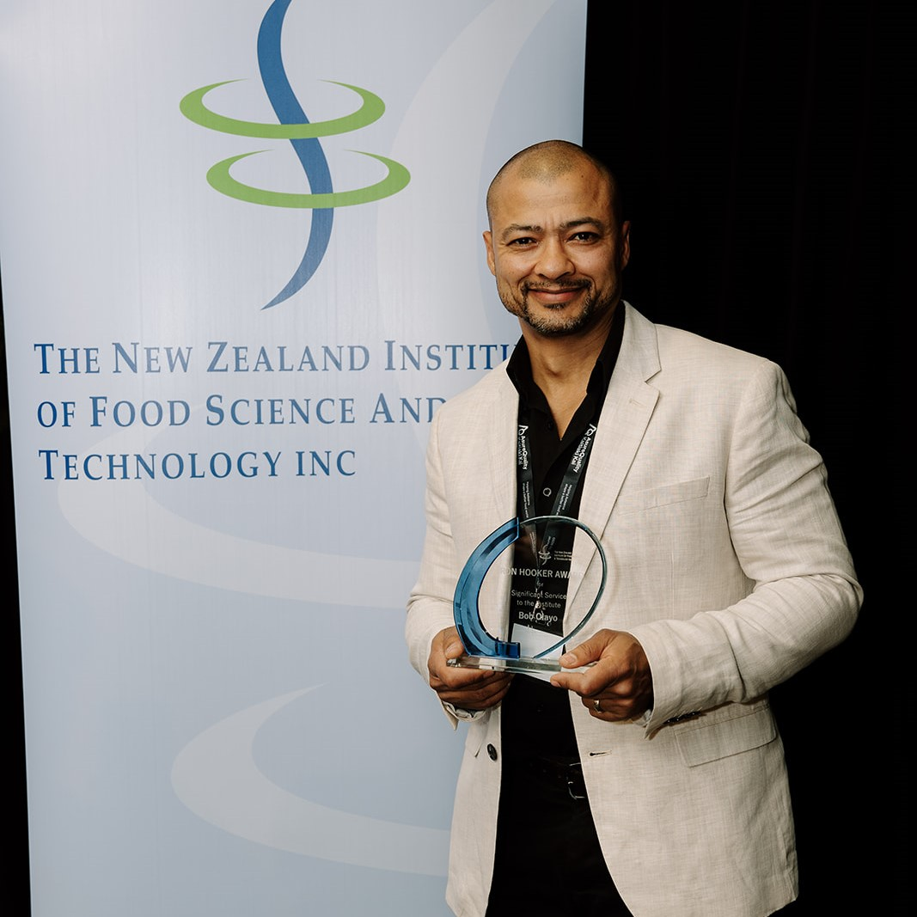
Ron Hooker Award – Bob Olayo
Established to honour the outstanding voluntary contribution given by Ron Hooker to the NZIFST since its formation in 1965, this award recognises significant past or current service or contribution to the NZIFST, developing the affairs of the Institute, its Branches or Divisions.
This year’s recipient has been a member of NZIFST for over 7 years. During this time, he has fulfilled several roles both at Branch and Board level. He has focused on growing membership through promoting value and learning opportunities.
He served on his local branch since 2016, on committee then as Branch Chair which led to a place as branch representative on the NZIFST Board.
His company has hosted branch committees for a number years and always actively promoted the affairs of the institute. He is also our branch photographer and zoom webinar host.
Among other things, he has worked closely with the local committee to increase member engagement through presentation and events, providing unwavering support to the Branch and the Institute.
One of his Key strengths is experience garnered over many years in industry.

Slide 12
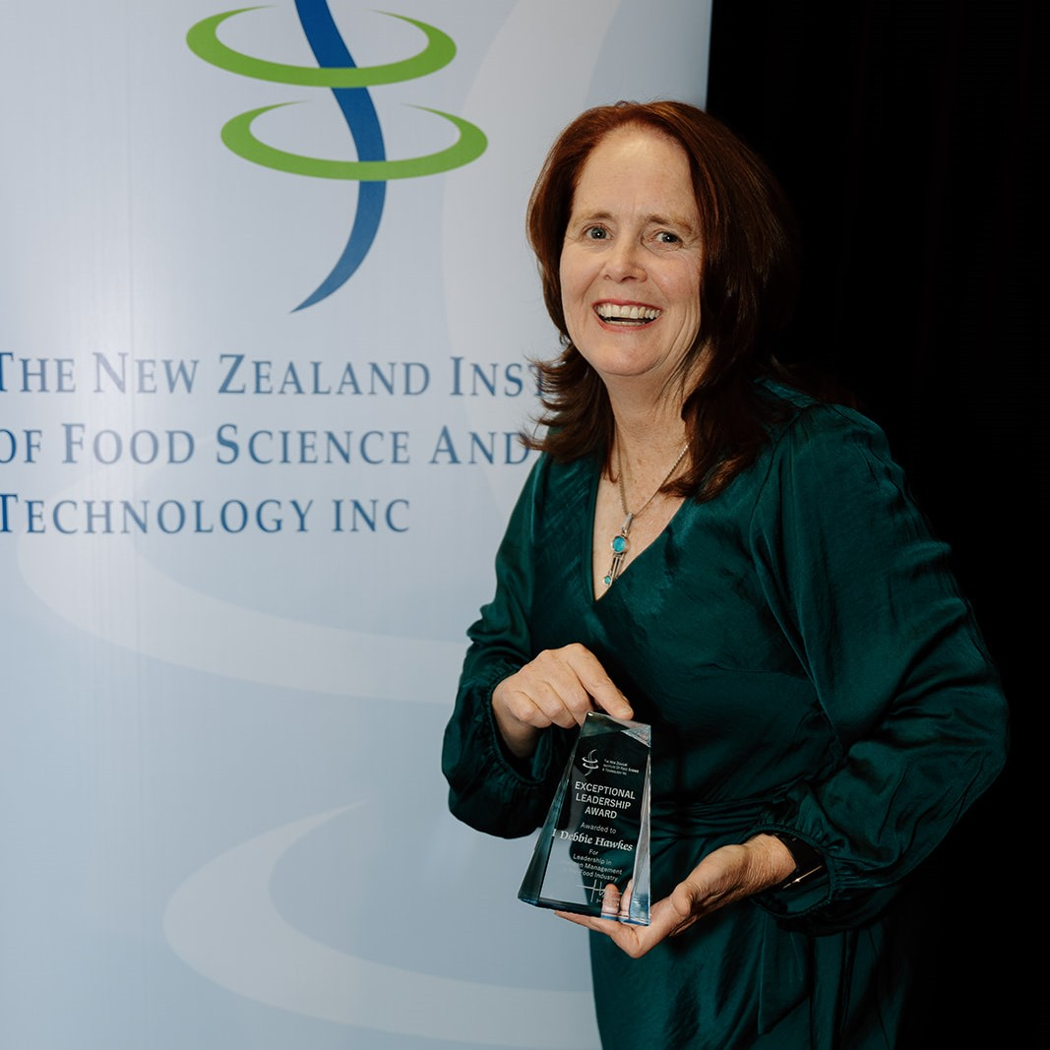
Exceptional Leadership In the Food Industry Award – Debbie Hawkes
Our winner tonight has a Food Technology degree from Massey University and has been working in the Food Industry for over 30 years. The majority of her career has been in New Zealand-based Quality and Food Safety Operational roles, for businesses such as Germantown, Danisco and Dupont marketers of food ingredient products covering Asia Pacific and South Asia regions. She is currently IT Systems & Process Manager at Hawkins Watts.
Her governance experience includes a term as NZIFST Auckland Branch Chair (1995-1997) and as a current board member of the Allergen Bureau.
As many here will know, she has an affinity for quality systems and information technology, an affinity that has enabled her exceptional contribution to the food industry.
She has been involved with the Allergen Bureau from the beginning when she was nominated in 2006 to represent Danisco, one of the Bureau’s Founding Members. Since then, her involvement has been continuous, participating in many Working Groups, and stepping up to a position on the Allergen Bureau Board in October 2017.
As industry and health systems developed better understanding of food allergens, it became clear that a framework was needed to build a quantitative allergen risk assessment tool and tonight’s awardee was instrumental in the initial development and creation of the Voluntary Incidental Trace Allergen Labelling (VITAL®) calculator, which was launched in 2007, in the form of a free, downloadable spreadsheet from the Allergen Bureau website. Many hundreds of downloads followed, as Australia and New Zealand food industry recognised the value of the VITAL calculator and what became an Allergen Bureau world-recognised achievement It is this contribution that we are recognising at this NZIFST 2024 Annual Conference.
Today we recognise the Excel-loving developer of the ‘First Architecture’ of VITAL , and the VITAL calculator. This remains today as an exceptional achievement that has underpinned the evolution of world-class allergen management within the Australia New Zealand and broader food industries, enabling scientifically-supported allergen information to be provided to thousands of food allergic consumers and their caregivers, who rely on accurate food labelling to keep them safe.

Slide 13
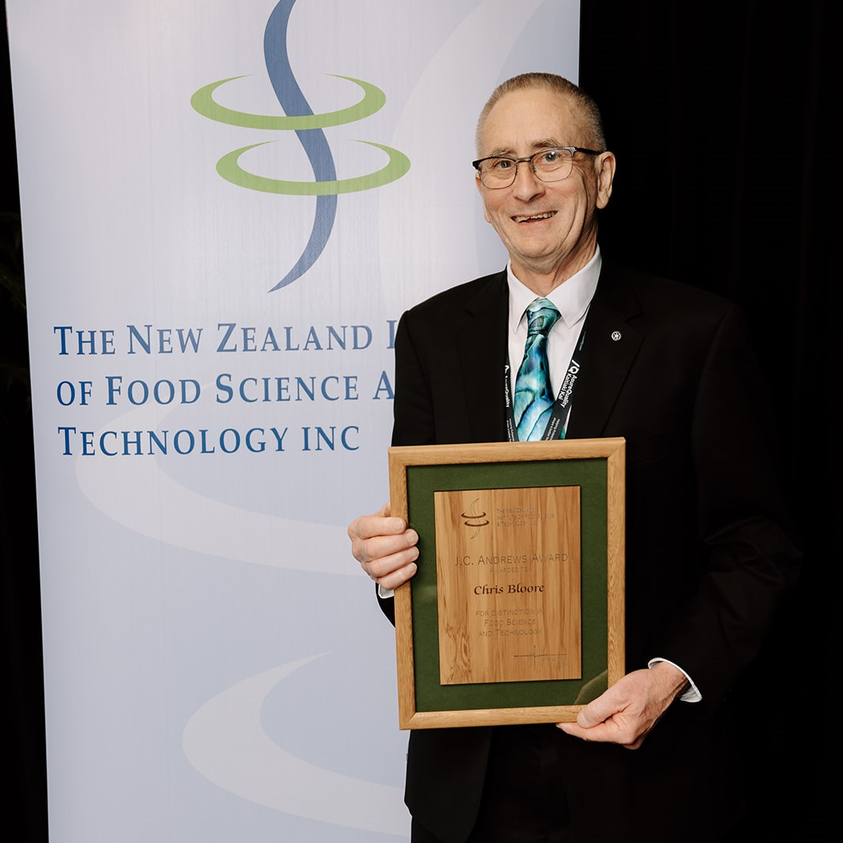
JC Andrews Award – Chris Bloore
Our 2024 J C Andrews Award winner’s career is distinguished by notable achievements, starting with his completion of a B.Sc. in Chemistry and a B.E. (Chemical Engineering Hons) from the University of Canterbury, New Zealand, followed by an MSc in Control Engineering from the University of Manchester, U.K., and a Ph.D. focusing on Spray drying from Massey University.
With a career spanning over five decades, he has amassed a wealth of experience and expertise. Initially, he served as a research chemical engineer at the NZ Dairy Research Institute for 19 years, followed by 32 years as a self-employed consultant. Throughout his career, he has been deeply engaged in training and educational initiatives across Australia, New Zealand, Europe, and the USA.
His early days at the NZ Dairy Research Institute in Palmerston North involved detailed research on spray drying with a focus on high pressure nozzle atomisation systems’ design and performance.
He was also heavily involved in developing control algorithms for optimisation of the spray drying process. The sticky point and glass transition defining work on drying powders helped many New Zealand operators significantly improve drying performance.
The advent of multistage and integrated spray drying systems in the New Zealand Dairy Industry brought much complexity to operating performance of spray driers.
Cont. on next page

Slide 14
JC Andrews Award – Chris Bloore
Cont. from prev. page
The algorithms he developed for the control of these more complex drying systems were widely used by industry to manage these processes.
As an active member of the NZIFST, he has made significant contributions to both industry education and the nurturing of young talents. His commitment to education is evident from his extensive lecturing experience, notably as part of the Dairy Graduate Training Programme and at the University of Otago.
He is internationally recognised as a leading expert in spray drier design, with his expertise showcased in his seminal work on dust explosions. His contributions extend beyond academia, as he led the development of crucial safety measures, including blast doors and suppression systems, which have undoubtedly saved countless lives and prevented extensive equipment damage.
Even in retirement, he continues to be actively involved in global training initiatives. His consultancy work, alongside his engagements with Men’s Shed and Rotary activities, speaks volumes of his dedication to community service.
In summary, his outstanding career, marked by ground-breaking contributions to his field and unwavering commitment to education and safety, is truly deserving of recognition and celebration. We wholeheartedly endorse him for this esteemed award.

